Slide 1

Customer Segmentation Overview
Understanding Your Market Through Data
Presented by: [Md.Zebha]
Department: [ECE]
Date: [18-10-2025]

Slide 2
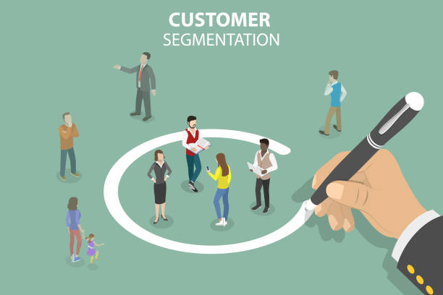
INTRODUCTION
Customer segmentation is the process of dividing a customer base into distinct groups.
Each group shares similar characteristics such as demographics, behavior, or needs.
Helps businesses tailor marketing strategies to specific audiences.

Slide 3
IMPORTANCE OF CUSTOMER SEGMENTATION
Improves marketing effectiveness.
Enhances customer retention.
Enables personalized communication.
Helps in product development.
Increases business profitability.

Slide 4
TYPES OF CUSTOMER SEGMENTATION
Demographic Segmentation – Age, gender, income, education.
Geographic Segmentation – Location, region, climate.
Psychographic Segmentation – Lifestyle, values, interests.
Behavioral Segmentation – Purchase behavior, loyalty, usage.

Slide 5
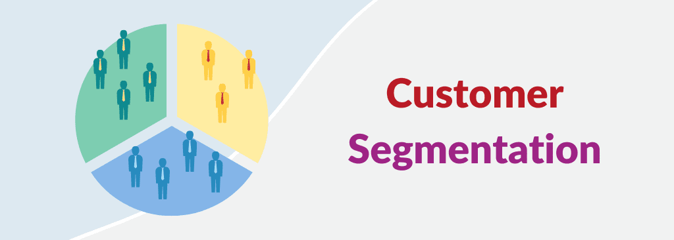
SEGMENTATION PROCESS
Data collection and analysis.
Identify segmentation variables.
Create customer profiles.
Evaluate segment attractiveness.
Develop targeted strategies.

Slide 6
TOOLS & TECHNIQUES
Data Analytics Platforms: Google Analytics, Tableau.
CRM Systems: Salesforce, HubSpot.
Statistical Techniques: Cluster analysis, RFM analysis.
AI & ML Models: Predictive segmentation, customer lifetime value analysis.

Slide 7
EXAMPLE CASE
Example: An e-commerce company segments its customers into:
- Bargain Seekers.
- Loyal Customers.
- Occasional Buyers.
- New Shoppers.
→ Tailors discounts, emails, and loyalty programs for each.

Slide 8
BENEFITS OF EFFECTIVE SEGMENTATION
Higher ROI in marketing campaigns.
Improved customer experience.
Better resource allocation.
Competitive advantage in market positioning.

Slide 9
CHALLENGES :
Data privacy and quality issues.
Over-segmentation.
Dynamic customer behavior.
Integration of multiple data sources.

Slide 10
FUTURE TRENDS
AI-driven segmentation.
Real-time personalization.
Predictive customer analytics.
Integration with omnichannel strategies.

Slide 11
CONCLUSION
Customer segmentation is key to strategic marketing.
It helps businesses understand customers deeply and act proactively.
Data-driven segmentation ensures long-term growth and loyalty.

Slide 12
REFERENCES
Kotler, P., Marketing Management.
HubSpot CRM Documentation.
McKinsey Insights on Customer Analytics.
Harvard Business Review, Customer-Centric Marketing.

Slide 13


